Slide 1

Batch Scripting
LogicOps Lab

Slide 2
Roadmap
Overview of Batch Scripting?
Files & Commands
Variables, Syntax, and Comments
Strings & Arrays
The famous If statement, If Else, and Nested If
Operators – Types
Input/Output, Return Codes
Functions
Process
Registry
Bonus topics

Slide 3
Overview
Audience
Anyone who wishes to learn.
Prerequisites
Not much, may or may not have any programming background. Just a zeal to learn. And, yes, a Windows PC/Laptop.
What is Batch Scripting?
Simple files which store commands that can be executed in Windows environment using command prompt in order to do some meaningful tasks are known as Batch Scripts.

Slide 4
Overview (contd.)
Features
Using Batch, we can do I/O operations that can be processed further.
We have various control loops for automation (For, If, While, etc).
We can play around Arrays and Function, which are some advanced concepts.
It supports RegEx and we can club this with Perl.

Slide 5
Overview (contd.)
Uses
Automation of various mundane tasks.
Automation of various deployment tasks in Windows OS.
Installing various applications on the system in one go.
Saving work-hours for the people.

Slide 6
Creation and Execution
Creation
a) Using notepad++
b) Any editor like Visual Studio code
Execution
a) From the same folder
b) Via run command

Slide 7
Commands
ver – Shows the version of MS-DOS
cd – Change Directory, helps you change the directory
md – Make directory, creates a directory
rd – Remove directory, deletes a directory
cls – Clears the screen
dir – Shows you all the contents of a directory
echo – Shows you the message that follows the command
exit – Used to close the console
rem – Comments a command
start – Starts the program in a new window
time – Displays the time
pause – Prompts and waits for the user to perform any action

Slide 8
Commands (contd.)
move – Moves files in various directories
path – This batch command displays or sets the path variable.
ren – Renames files and directories
type – This batch command prints the content of a file or files to the output.
vol – This batch command displays the volume labels.
find – This batch command searches for a string in files or input, outputting matching lines.
help – This batch command shows the list of Windows-supplied commands.
ipconfig – This batch command displays Windows IP Configuration. Shows configuration by connection and the name of that connection.
ping – It sends ICMP/IP "echo" packets over the network to the designated address.
sort - This batch command takes the input from a source file and sorts its contents alphabetically, from A to Z or Z to A. It prints the output on the console.
taskkill – This batch command ends one or more tasks
tasklist – It lists tasks, including task name and process id (PID)
Fc - This batch command lists the actual differences between two files

Slide 9
Syntaxes, Variables, and Comments
Syntaxes
How do you frame your program?
Variables
Playing around setting up and passing the arguments
Comments
Controlling what your program shows and what not

Slide 10
Variable Scope & Strings
Variables
Local Variables – Defined boundary in which they can accessed.
Global Variables – They do not have a defined boundary, and they can be used anywhere in the whole script.
Strings
A String is an ordered collection of the characters
Eg – “Hi, Guys! This is a String”

Slide 11
Strings – Functions used
Concatenation - You can use the set operator to concatenate two strings or a string and a character, or two characters.
Interpolation - String interpolation is a way to construct a new String value from a mix of constants, variables, literals, and expressions by including their values inside a string literal.
toInt - A variable which has been set as string using the set variable can be converted to an integer using the /A switch which is using the set variable.
Length - In DOS scripting, there is no length function defined for finding the length of a string. There are custom-defined functions which can be used for the same.

Slide 12
Strings – Functions used (contd)
Right and Left String – Extracting characters from the beginning or end of the string.
Mid – Extracting a substring from a position in any string.
Remove (Space, Both Ends) - Used to remove a substring from another string or to remove the first and the last character of a string.
Replace - To replace a substring with another string. In easier words, the string substitution feature.

Slide 13
Making Decisions
In order to make decisions whether one or more condition(s) must be executed or not we use these statements
If statement
If-else statement
Nested-if statements

Slide 14
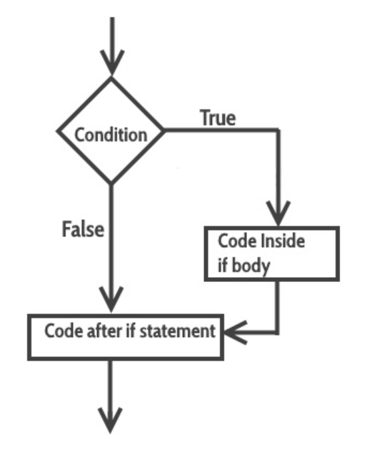
Making Decisions (contd)
If statement
The statements inside the body of “if” only execute if the given condition returns true. If the condition returns false then the statements inside “if” are skipped.
Syntax :
if(condition) do_some_work

Slide 15
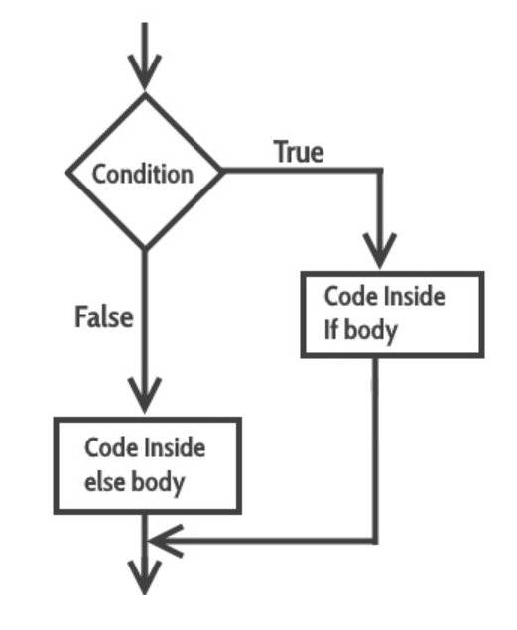
Making Decisions (contd)
If - else statement
If condition returns true then the statements inside the body of “if” are executed and the statements inside body of “else” are skipped. If condition returns false then the statements inside the body of “if” are skipped and the statements in “else” are executed.
Syntax :
If (condition)
(do_something)
ELSE
(do_something_else)

Slide 16
Making Decisions (contd)
a) Nested If statement
Sometimes, there is a requirement to have multiple ‘if’ statement embedded inside each other. Following is the general form of this statement.
Syntax - if(condition1) if (condition2) do_something
Thus, only if condition1 and condition2 are met, will the code in the do_something block be executed.
Goto statement
The capability to hop to a particular section is provided by the appropriately named "goto" command
Syntax - .....
goto :label
.....some commands to run
:label
.....some other commands to run

Slide 17
Operators
An operator is a symbol that tells the compiler to perform specific mathematical or logical manipulations. We have the following types in Batch scripting
Arithmetic
Relational
Logical
Assignment
Bitwise

Slide 18
Arithmetic Operators
Batch supports any Arithmetic operator like other languages
Operator | Explanation | Working Example
+ | Addition of two or more operands | 2 + 3 + 5 will give us 10
- | Subtraction of the operands | 10 – 4 will give us 6
/ | Division of the operands | 10 / 10 will give us 1
* | Multiplication of the operands | 10 * 10 will give us 100
% | Modulus operator for the remainder after division | 16 % 3 will give us 1

Slide 19
Relational Operators
These operators allows the comparison of objects
Operator | Explanation | Working Example
EQU | It will test the equality between two objects | 4 EQU 4 will give true
NEQ | It will test the difference between two objects | 4 NEQ 2 will give true
LSS | It will check to see if the left object is less than the right operand | 2 LSS 4 will give true
LEQ | It will check to see if the left object is less than or equal to the right operand | 2 LEQ 4 will give true
GTR | It will check to see if the left object is greater than the right operand | 4 GTR 2 will give true
GEQ | It will check to see if the left object is greater than or equal to the right operand | 4 GEQ 2 will give true

Slide 20
Logical Operators
These operators are used to evaluate Boolean expressions
Operator | Description
AND | It is logical “and” operator
OR | It is logical “or” operator
NOT | It is logical “not” operator

Slide 21
Assignment Operators
Operator | Description | Example
+= | This adds right operand to the left operand and assigns the result to left operand ( a = a + 30 ) | Set /A a = 50 a += 30 Output will be 80
-= | This subtracts the right operand from the left operand and assigns the result to the left operand ( a = a – 30 ) | Set /A a = 50 a -= 30 Output will be 20
*= | This multiplies the right operand with the left operand and assigns the result to the left operand ( a = a * 30 ) | Set /A a = 50 a *= 30 Output will be 1500
/= | This divides the left operand with the right operand and assigns the result to the left operand ( a = a / 30 ) | Set /A a = 60 a/ = 30 Output will be 2
%= | This takes modulus using two operands and assigns the result to the left operand ( a = a % 30 ) | Set /A a = 50 a% = 30 Output will be 20

Slide 22
Bitwise Operators
Operator | Description
& | Bitwise “and” operator
| | Bitwise “or” operator
^ | Bitwise “xor” or Exclusive or operator
Concept explanation
a | b | a & b | a | b | a ^ b
0 | 0 | 0 | 0 | 0
0 | 1 | 0 | 1 | 1
1 | 1 | 1 | 1 | 0
1 | 0 | 0 | 1 | 1

Slide 23
Loops
A Loop executes the sequence of statements many times until the stated condition becomes false. A loop consists of two parts, a body of a loop and a control statement. The control statement is a combination of some conditions that direct the body of the loop to execute until the specified condition becomes false. The purpose of the loop is to repeat the same code a number of times.
FOR Loop
FOR /L %%variable IN (LowerLimit, Increment, UpperLimit) DO Your_Code_To_Do_Something
Here, /L switch is used to denote that the loop is used for iterating through ranges.
IN contains three values
After DO, your code that will be executed

Slide 24
Arrays
An Array is a collection of data items, all of same type, accessed using a common name. We do NOT have Arrays specifically designed as a type in Batch Scripting, but we for sure can implement them. This is how we do it
Use SET command to define each element of an Array.
To iterate the values, use ‘FOR’ loop.
Syntax: SET YourArray[0]=1
Here, SET is the command, A is Array Name, [0] is the index at which the value (1) is going to be assigned.

Slide 25
Arrays (contd)
We will do the following in our demo today
Array creation
Accessing the Arrays (Through index values)
Modification in an Array (Adding/Removing any element in an Array)
Array iteration (By using FOR loop)
Bonus script: Hands-on
Calculating Length of an Array

Slide 26
Functions
A function can be defined as a set of statements organized together to perform a specific task. Similarly, in batch scripting, we will group logical statements together to form a function. They are the de facto way to reuse the code, we do not have a keyword like ‘Function’ but use CALL and LABELS to make it happen.
It has two parts :-
Declaration – Where you tell the compiler the function name, return type, parameters, etc.
Definition – Here you define your function which acts as an actual body of a function.

Slide 27
Functions
Syntax - :your_function_name
Your_function_body_to_do_something
EXIT /B [exitcode]
EXIT /B at the end of the batch file will stop execution of a batch file
use EXIT /B [exitcodes] at the end of the batch file to return custom return codes
use EXIT /B %ERRORLEVEL%, it contains the latest errorlevel in the batch file
Calling a function : We use the CALL keyword to invoke the function, we can pass command line arguements, as well
Return values : It should be always be the exitcode of the function, the caller reads %ERRORLEVEL% to get the exit code.

Slide 28
Input/Output with Files
Files
A File is a collection of information which is recorded/saved in our hard disks
Creating files
Reading files
Writing to files
Deleting files
Renaming files

Slide 29
Input/Output with Folders
Folder
A folder is a directory where you keep your content
Creating folders
Listing contents
Deleting folders
Renaming folders
Moving folder

Slide 30
Registry
What is Registry?
The database where all the settings of the Windows are stored is called a Registry. It is arranged in a hierarchical order to retrieve data whenever needed and used in the system.
It has two parts:
Keys - Registry keys are container objects like folders. Keys may contain values or further keys. Keys are referenced with a syntax like Windows path names, using backslashes to indicate levels of hierarchy.
Values - Registry values are non-container objects like files.

Slide 31
Registry (contd)
Operations
Reading from Registry
Adding into Registry
Deleting from the Registry
Copying Keys from Registry
Comparing Keys from Registry

Slide 32
Process and Logging
Processes are the related activities inside a system that works together to do something.
A log file is a file that records either events that occur in an operating system or when software runs, or messages between different users of a communication software. Logging is the act of keeping a log.
What will we try today?
How to get the list?
How to log it in a text file?
Killing a process
Starting a new process

